Slide 1
What are TextP2P credits?
And how do you use them?

Slide 2
Credit costs
SMS outgoing text
1 credit
MSM outgoing text
2 credits
Ringless voicemail message
2 credits
Note: each person receiving the message will cost credits

Slide 3
What is an SMS Text
An SMS text is a simple text message that does not include pictures, videos, etc.
Max length is 160 characters
If you use emojis your max length is 134
Text can be split for a total of 305 characters but costs 2 credits

Slide 4
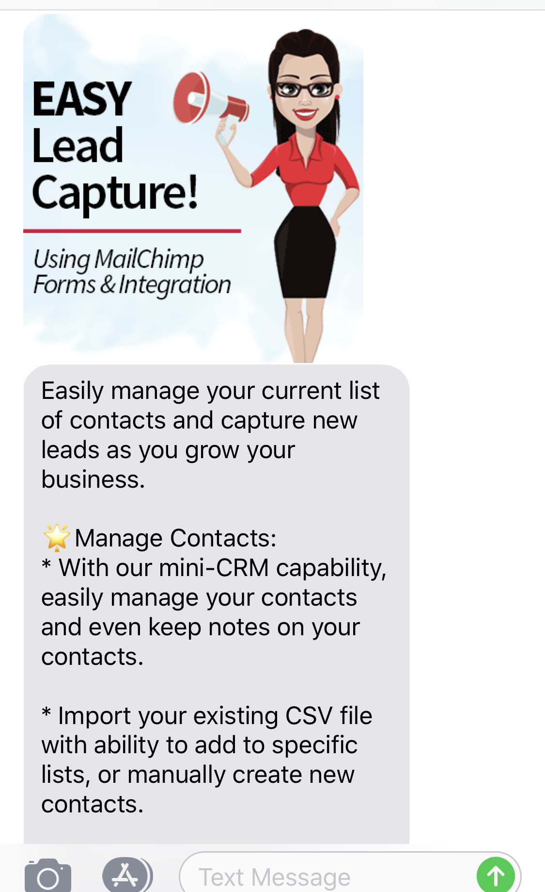
What is an MMS Text
An MMS (Multimedia Messaging Service) is a text which can include a picture, video, audio, or PDF document under 1 MB
Max length is 1600 characters
If you use emojis your max length is still 1600

Slide 5
Plan Pricing

Slide 6
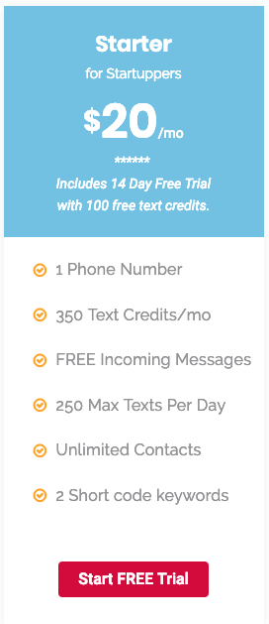
Send 250 SMS texts on day 1, then send 100 on day 2
Send 125 MMS texts in one day
Send 10 SMS texts a day for 25 days
Buy add-on credits to send more

Slide 7
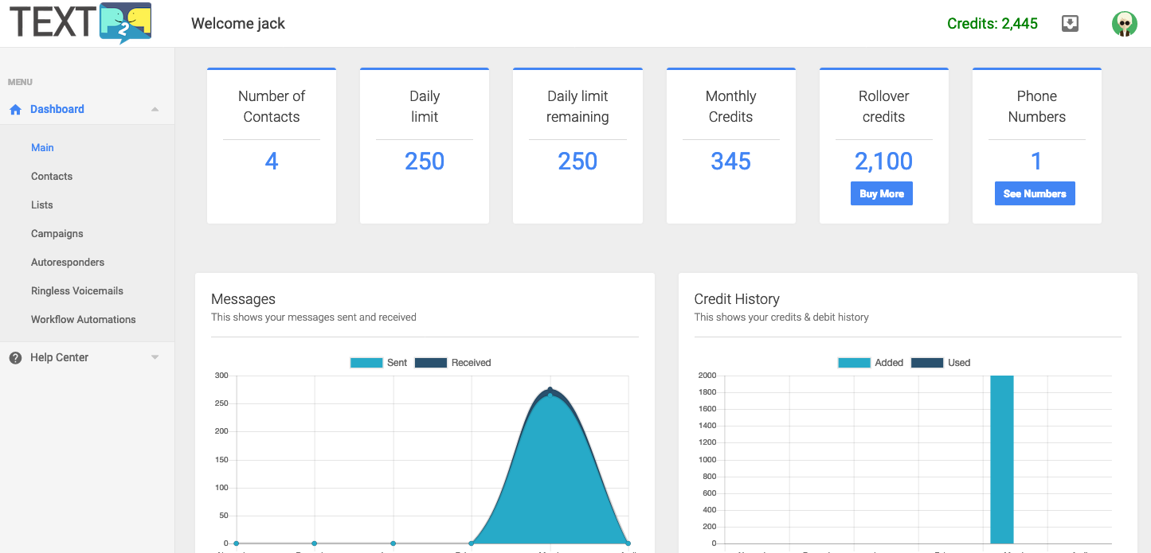
Find your credits

Slide 8
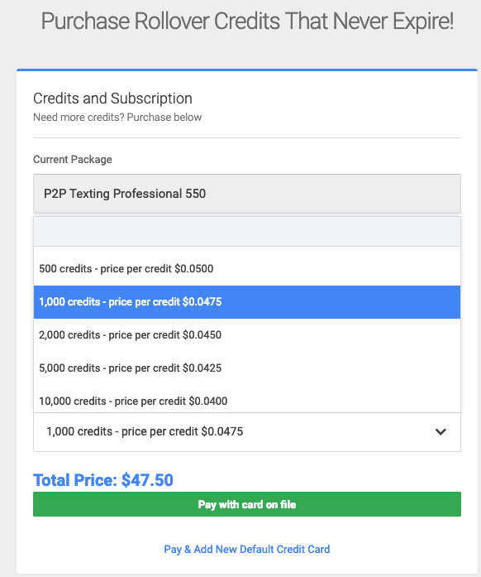

Slide 9
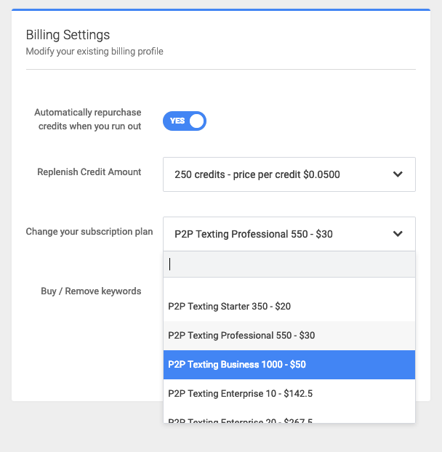
Upgrade your plan

Slide 10
Questions? Email support@textp2p.com or text (703) 420-5715

